Slide 1
Study Buddy

Slide 2
Meet the Team
Melissa Cron - Project Leader
Shinu Shibu - Configuration / Requirements Leader
Bohan Lin - Quality Assurance / Design Leader
Kimi Chen - Security Leader
Elijah Zhang - Quality Assurance / Design Leader
Mia Zhao - Quality Assurance / Design Leader
Notes:
Picture, name, and role of all members

Slide 3
About Study Buddy
DexiaoZhang（Elijah）
Notes:
Elijah
Describe the goal of the project.

Slide 4
What is Study Buddy?
A companion app that helps students study consistently with goals, focus mode, gamification and progress tracking.
Helps students build consistent study habits
Includes focus timer, weekly goals, and study statistics
Gamified with relaxing mini-games as rest breaks
Personalized virtual buddy to motivate studying

Slide 5
Why Study Buddy?
Bullet points：
Students struggle with consistency and motivation
Our app makes studying less stressful and more engaging
Visual progress & a supportive buddy encourage long-term habit forming
Designed to improve focus while preventing burnout

Slide 6
Key Features
Feature list：
✅ User Registration & Login
✅ Personalized Study Buddy
✅ Focus Mode Timer (Pomodoro-style)
✅ Weekly Goal Tracking
✅ Game Center with 3 Mini-Games

Slide 7
Demo
Notes:
Melissa
Have demo that shows these aspects:
Signing up and logging in
Changing the settings for the Buddy Studying
Playing the game
Not studying - thus dying

Slide 8


Slide 9
Project Management
Notes:
Melissa
Meetings
Reminders
Deadlines
Updating Jira to track progress

Slide 10
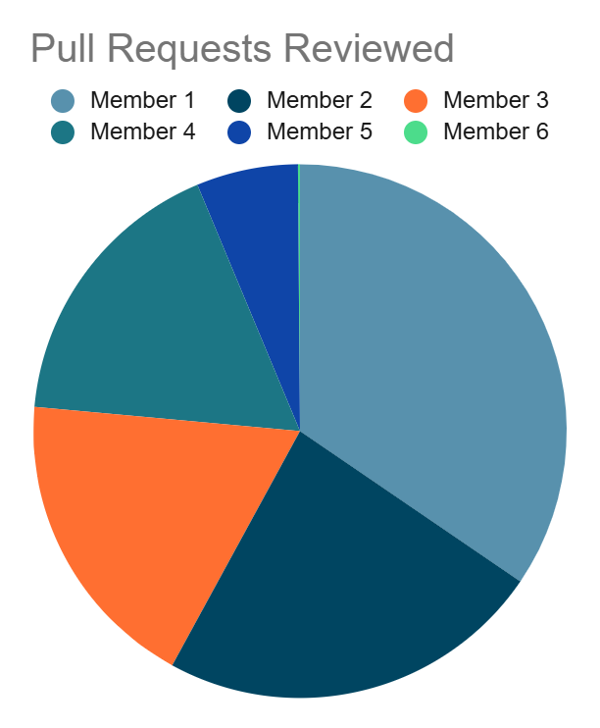
Pull Requests
Longest time from request to FIRST review
11 days
Reduced required reviews to 1
Assigned specific people
Didn’t work

Slide 11


Meetings
Iterations 0 - 2
Poor participation
Not much achieved
Long
Iteration 3
Planned minute by minute
Circle back
Contributing by vote

Slide 12
Requirements Analysis
Notes:
Shinu
Building original requirements
Prioritizing requirements
Making Jira tickets

Slide 13
Requirements Management in Our Project
How we managed requirements:
Requirements tracked entirely in Jira (KAN board)
Each feature created as a user story with subtasks
Requirements refined during structured meetings
UI mockups (two versions) used to clarify functional expectations
Backend API & DB schema drove technical requirements
Testing output fed back into requirement refinement

Slide 14
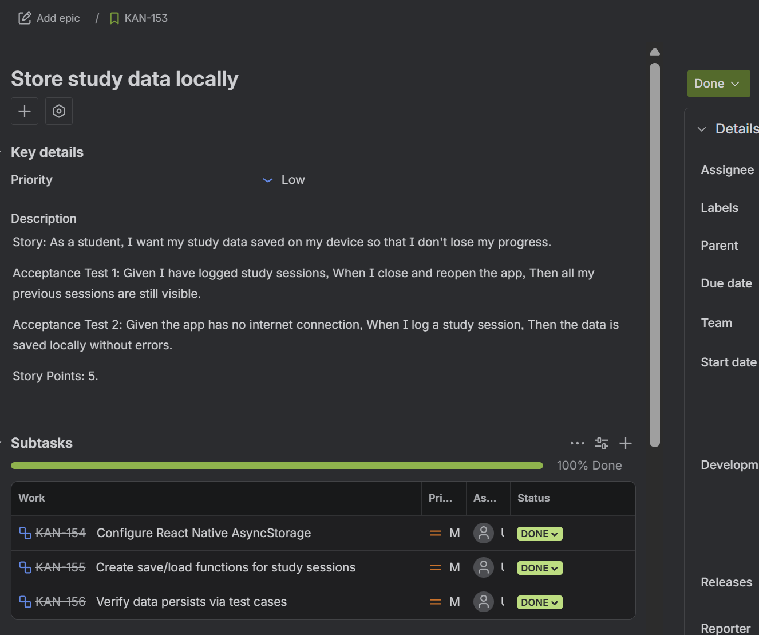
Requirements Tracking & Traceability
How we kept requirements traceable:
Each Jira story mapped to:
A feature branch
A PR that referenced the Jira ticket
Specific frontend components / backend routes
Corresponding test cases

Slide 15
Requirements Changes Across Iterations
Iterations 0–1: Slow progress, unclear responsibilities
Iteration 2:
Prioritized stories via group voting
Requirements adjusted to fit time constraints
Final iteration:
Scope trimmed
Focus on stability
Only feasible features included in final build
Completed 75 Stories Over The Course Of All Iterations

Slide 16
Visual / Frontend Design
Notes:
Kimi
Using Figma
Turning Figma into code

Slide 17
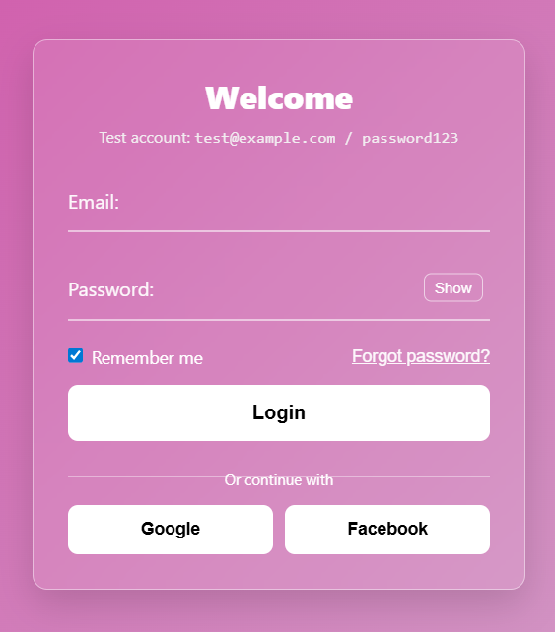
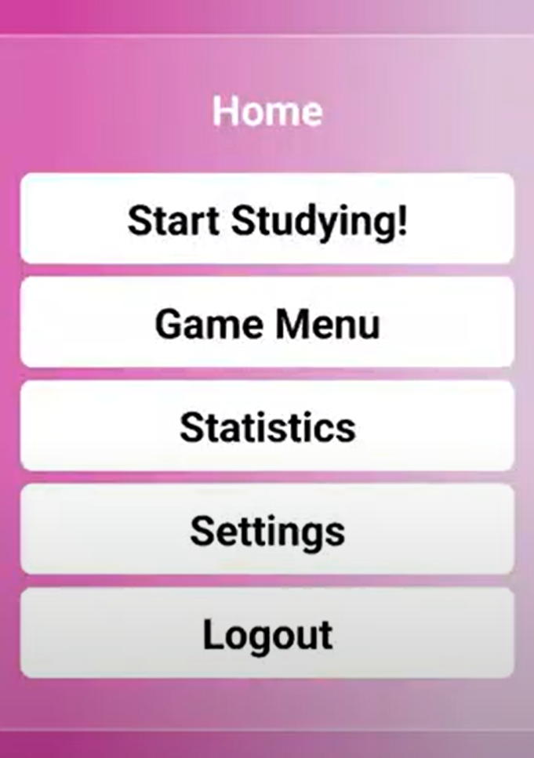
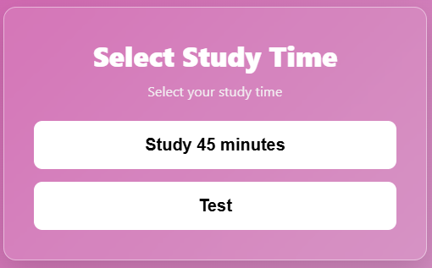
The first version
Notes:
This was our initial UI design. It was very simple and basic, just generated directly using some HTML styles. As a user interface, we needed to add some interactive features. After several team meetings, we found the final solution: using a navigation bar. A bottom-mounted navigation bar is both aesthetically pleasing and easy to use.

Slide 18
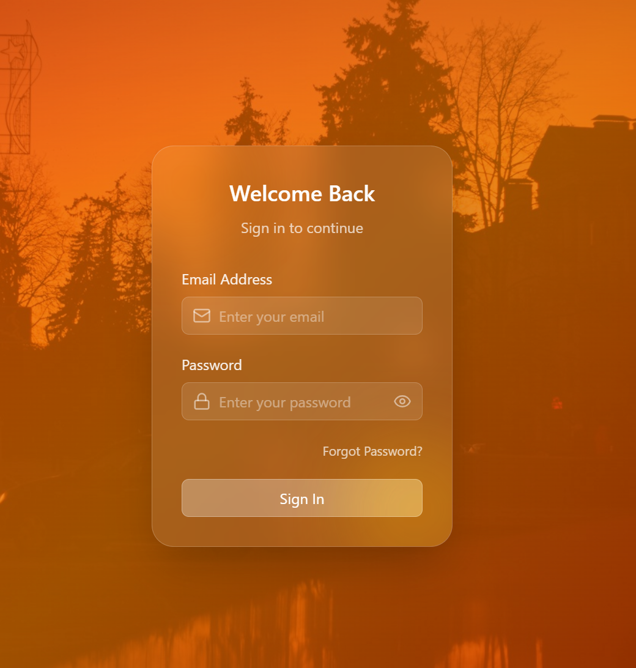
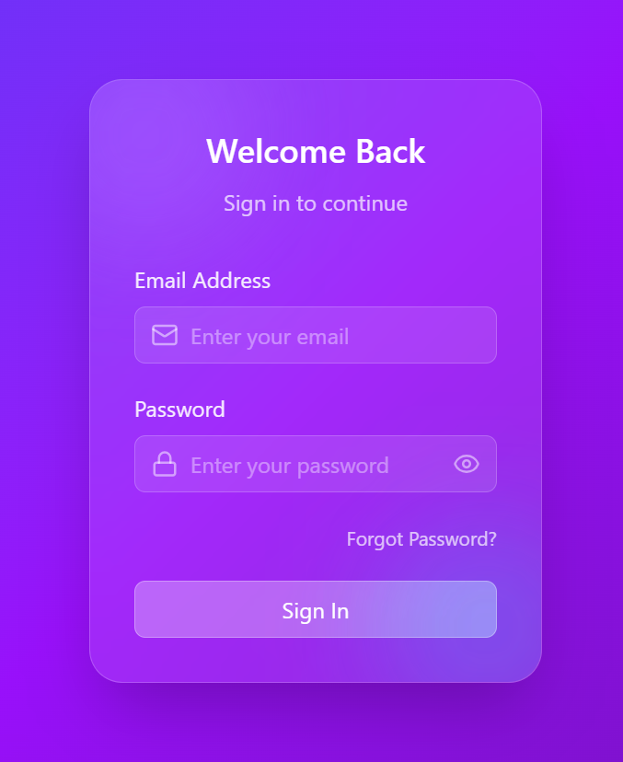
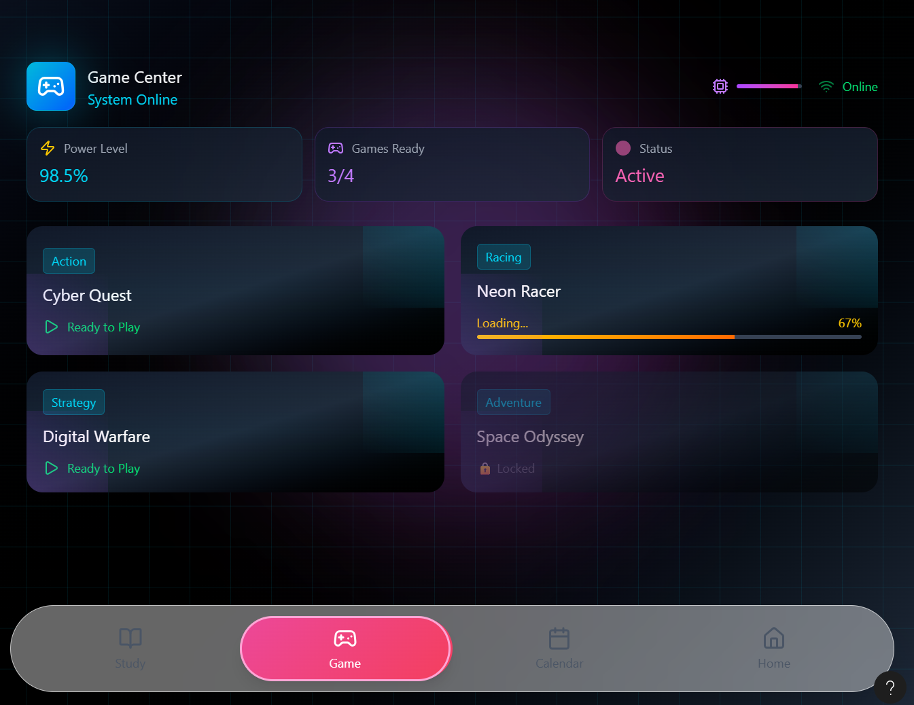
Background selection
Notes:
This is how we've evolved, from having flashy designs on every interface to a unified and welcoming style.

Slide 19
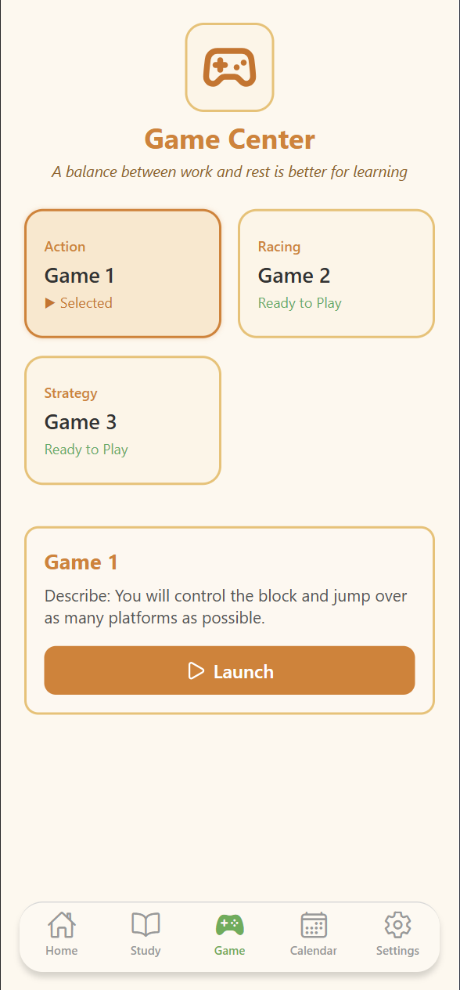
Final version

Slide 20



Production process
Figma Flutter React
Notes:
Finally, this is our front-end development process.
We first build the demo, then select the most suitable and satisfactory one to create the actual pages.
The advantage of this approach is that the work can be done in same time — Since creating a demo is the fastest part, once the demo is ready, we can publish tasks in Jira.
Team members can then choose which page they want to work on and start development.
This allows everyone to work simultaneously on the front-end pages, significantly improving overall efficiency.

Slide 21

Backend Design
01
02
ONE
TWO
Node.js + Express
Modular Architecture
03
THREE
Middleware-based System
04
05
FOUR
FIVE
RESTful API
SQLite relational database

Slide 22
Modular Architecture:
Client
Middleware
Routes
Models
Database
Backend Structure：
/db - database connection & scheme
/routes - API endpoints
/models - business logic
/middleware - auth + logging
# improve security and debugging
auth.js - route protection
logger.js - request tracking
rateLimiter.js - limit request
Notes:
The backend is separated into database, routes, models, and middleware.
Requests go through middleware first, then routes, which call business logic in the models, and finally access the database.
We created custom middleware to handle authentication and logging.
This improves both security and system monitoring.
Routes define API endpoints that handle HTTP requests and responses.
Models describe how data is stored and accessed.
The database folder manages SQLite connections and queries. The frontend communicates with the backend using RESTful APIs (GET, POST, PUT, DELETE), while the backend interacts with the database for persistent storage.

Slide 23

RESTful API Design
Follows RESTful architecture
Uses standard HTTP methods
JSON-based communication
Protected with auth middleware
Example Endpoints:
POST /api/profiles/me
GET /api/profiles/me
POST /api/users/register
GET /api/users/me
Notes:
Our backend exposes a RESTful API that follows standard web architecture.
We used common HTTP methods such as GET, POST, PUT, and DELETE.
All data is transferred in JSON format, and protected routes use authentication middleware.
This makes our backend consistent, secure, and easy for the frontend to connect to.
This design also makes our system scalable and maintainable.

Slide 24

Database Choice
Database: SQLite
Why SQLite?:
Lightweight & serverless: Requires minimal setup and overhead.
Easy to setup and deploy: Simplifies the development process.
Perfect for small-to-medium apps: Provides sufficient performance for the project scope.
Works well with Node.js: Integrates seamlessly with the backend environment.
SQLite runs directly as a file on the server, simplifying management.

Slide 25
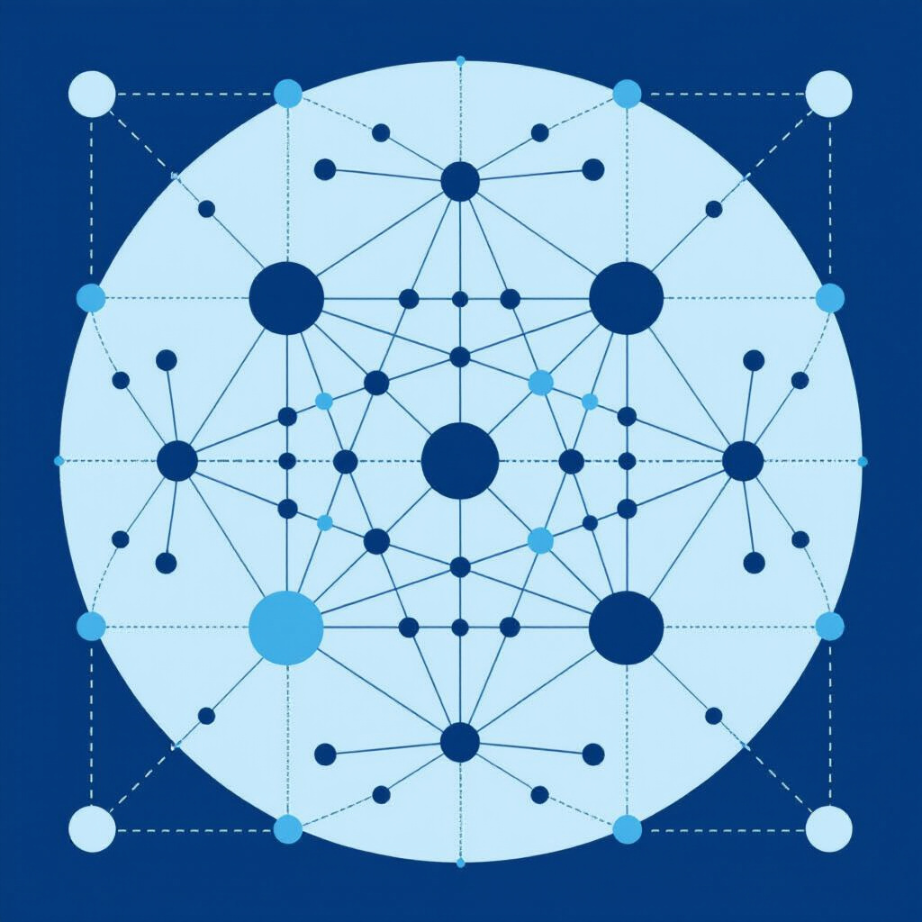
Database design (Relational model)
We use a relational database design:
users
study_sessions
study_buddies
Each table has a primary key and is connected by foreign keys to model relationships.
One user → Many study sessions
One user → Many study buddies
This structure ensures:
Reduced data redundancy by normalizing the data.
Data integrity through defined relationships and constraints.
Easy querying using SQL for efficient data retrieval.
Notes:
The Users table is the core. All other tables are connected through foreign keys.
This normalized design reduces redundancy and improves data consistency.
We introduced a study_progress table for active timer to allow session data to persist, even if the app is closed.
This supports features like resuming timers across devices.

Slide 26
Testing
DexiaoZhang（Elijah）
Notes:
Elijah
Unit tests
Manual tests
Full Tests
% covered

Slide 27
Testing Strategy
We applied a multi-layer testing strategy across the entire Study Buddy system.
Frontend tests: UI rendering, navigation, form validation, and user actions.
Backend tests: REST API endpoints, authentication, input validation, DB operations.
Automated testing with Jest + React Native Testing Library + Supertest.Enabled coverage to evaluate code quality and completeness.

Slide 28
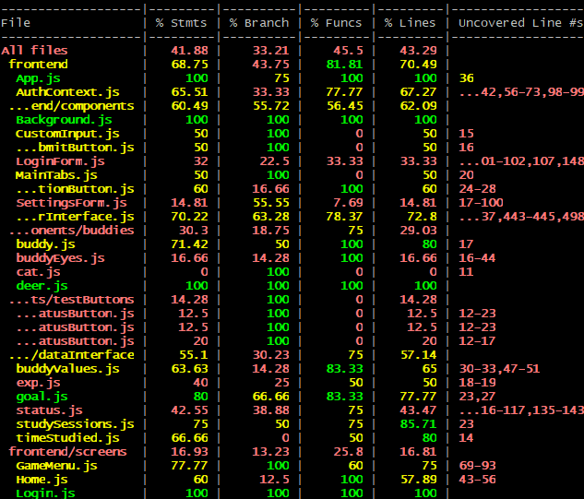
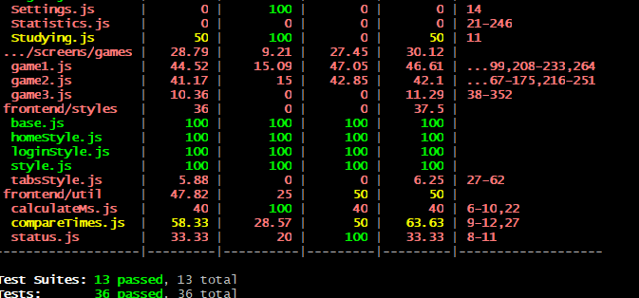
Frontend Testing

Slide 29
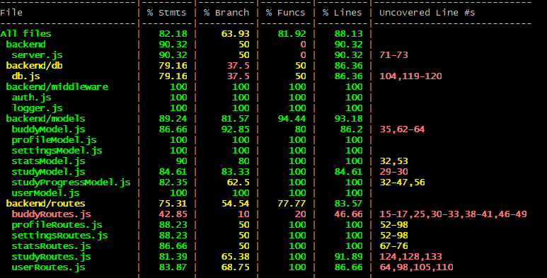
Backend Testing

Slide 30
Test Coverage & Reliability
Frontend coverage: Statements ~68%, Branches ~33%, Functions ~43%.
Backend coverage: Statements ~82%, Functions ~81%, Lines ~88%.
No flaky tests; all tests run under 8 seconds.
Ensured stable releases and safe feature merges.

Slide 31
Configuration & Docker
Notes:
Shinu - whatever is appropriate

Slide 32
Repository Structure Supporting Config Management
Why this structure matters:
Clear boundaries between backend and frontend
Easier PR reviews and conflict resolution
Predictable build environments
/backend
Dockerfile
/frontend/
Dockerfile.prod
Dockerfile.dev
docker-compose.yml
– DB schema + Authentication
– Backend container
– React Native UI
– Frontend prod container
– Frontend dev container
– Multi-service orchestration

Slide 33
Git Workflow & Branching Strategy
Branching model used:
main → stable, final release
develop → integration branch
feature/* → each Jira requirement implemented in its own branch
hotfix/* → each hotfix implemented in its own branch
Final workflow For PRs:
Small PRs for each feature/PR
Automated tests run on every PR
Required tests and security checks to pass on every PR before merging

Slide 34
GitHub Workflow Automation & Security Tooling
CI/CD Automation (GitHub Actions):
Our pipelines automatically run whenever code is pushed or a PR is opened:
Install dependencies (frontend + backend)
Run Jest / React Native / Supertest test suites
Build backend + frontend Docker images
Run tests inside Docker to validate image integrity
Block merges when tests or build steps fail

Slide 35
GitHub Workflow Automation & Security Tooling
Security Automation Integrated Into GitHub Workflows:
CodeQL (Static Application Security Testing)
Static analysis for vulnerabilities in backend + frontend
Detects injection risks, insecure dataflow, and API misuse
Runs on every PR and weekly scheduled scans
TruffleHog (Secret Scanning)
Scans commits and PRs for leaked secrets
Detects API keys, JWT secrets, passwords, tokens
Blocks merges if secrets are found

Slide 36
GitHub Workflow Automation & Security Tooling
Security Automation Integrated Into GitHub Workflows:
OSV Scanner (Open Source Vulnerability Scanner)
Scans project dependencies against the Google OSV vulnerability database
Identifies known vulnerabilities in npm packages and transitive deps
Ensures both backend & frontend libraries stay patched
Dependabot Alerts & Security Updates
Monitors npm packages for CVEs
Automatically creates PRs to upgrade unsafe dependencies
Integrated into GitHub Security dashboard

Slide 37
Summary On CI/CD
How we controlled changes across the project:
Jira → source of truth for requirements
Git branches → mapped to each requirement
PRs → documented implementation choices
Tests → validated requirement completion
Docker/GitHub Actions → ensured consistent environment +testing + security+deployment
Result:
Every feature/fix is linked, tested, and reproducible.

Slide 38
Security
Notes:
Bohan
Talk about our security measures
Demo - show the login/registration failing
Frontend vs backend
Encryption, JWT, frontend password constrain, status constrain

Slide 39
01
02
03
04
Authentication Security
Frontend Security
Data Protection
Session Management
User identity is unique and verified during registration. Passwords are hashed with bcrypt.
Frontend enforces password strength rules to prevent weak passwords.
All communication uses HTTPS to protect sensitive data in transit.
Server issues JWT tokens for stateless authentication. JWT tokens have expiration to prevent reuse.
Notes:
For security, our application is designed to protect user data from the very first step — registration.
First, every user must register with a unique identity. We do not store passwords as plain text. Instead, we use bcrypt to hash passwords before saving them in the database. This means even if someone gained access to the database, they would not be able to read the original passwords.
Second, on the frontend, we enforce strong password rules. Users are required to create passwords that meet a minimum length and complexity requirement, including a mix of uppercase letters, lowercase letters, numbers, and symbols. This helps prevent weak or easily guessable passwords.
Third, all communication between the client and the server is protected using HTTPS. This ensures that any data being transmitted — such as login credentials and user information — is encrypted and cannot be easily intercepted by attackers.
Finally, our server uses JWT tokens for stateless authentication. After a user successfully logs in, the server generates and sends a JWT token to the client. This token is required for accessing protected routes, and it also has an expiration time, which prevents long-term reuse and reduces the risk if a token is ever exposed.
In addition, we implemented rate limiting on the server side using Express Rate Limit.
For general API routes, each IP address is limited to 1,000 requests every 15 minutes, which helps prevent abuse and protects server resources.
For more sensitive authentication routes such as login and registration, we applied a stricter limit of 20 requests every 15 minutes per IP.
This significantly reduces the risk of brute-force attacks and automated abuse attempts.
Altogether, these measures help us ensure the confidentiality and integrity of our users’ data.

Slide 40
AI Use
Text Generation
ChatGPT | Gemini | DeepSeek | Kimi
Code Assistance
ChatGPT | GitHub Copilot | Copilot | DeepSeek | Gordon | Cursor | Codex
Image Generation
Midjourney | Figma | Nanobanana | Pixso | Sora
Knowledge Management
ChatGPT Memory
Notes:
These are some of our most commonly used AI software programs. Different AI programs can produce dramatically different results in different environments.

Slide 41
Text Generation
1. Correcting grammatical and typographical errors (ChatGPT | Gemini)
2. Make the description more professional ( DeepSeek | Kimi )
Notes:
AI-generated text is primarily used for SDD or STD files. Its main purpose is to increase the accuracy of language descriptions.Its main use is to allow AI to optimize the text and correct errors after it has been written. Chatgpt is the most frequently used.

Slide 42
Image Generation
Create Study Buddy (Sora | Nanobanana | Midjourney)
Design frontend ( Figma | Pixso)
Notes:
Image generation, including images of our animals, is achieved using Sora and Nanobanana. Nanobanana is used to find the original images, while Sora is used to generate other emojis. Figma primarily generates an interactive front-end page template.

Slide 43
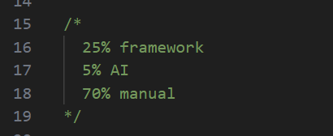
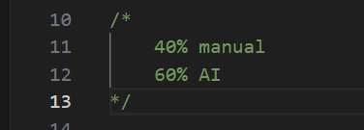
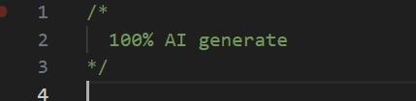
Code Assistance
Help to use application (GitHub Copilot | Copilot)
Fix bugs ( ChatGPT | DeepSeek | Gordon | Cursor | Codex)
Generate test code (ChatGPT | DeepSeek)
Optimize the algorithm's complexity (ChatGPT | DeepSeek)
Notes:
In terms of code, our most impressive use was having AI write test scripts for us. This is because AI can think more comprehensively than we can. Secondly, we used AI for bug fixing, mostly using chatgpt. If there were environment configuration issues, our team members primarily used copilot.

Slide 44
Games
Notes:
Mia

Slide 45
Why mini games?
Support Focus Mode: provide short, bounded rest breaks
Reduce cognitive fatigue → increase overall study consistency
Reward user progress (intrinsic + gamified motivation)
Improve user retention through interactive elements
Each game session provides structured, time-restricted rest (not distractions)
System Role in Study Buddy
Games integrated into study cycle → only available after timer session
Game performance (e.g., highest score) connects to reward system (future extension)

Slide 46
Functional Requirements
Time-Restricted Gameplay
Game session available only after particular study session
User cannot extend gameplay beyond allowed break duration
Score Tracking
Session score calculated differently per game
Score displayed in real-time during gameplay
Highest score stored locally (SQLite via backend API planned)
Mobile-Friendly Controls
Single-tap / press interactions only
Game parameters adjusted in real time according to screen ratio
Seamless Navigation
Enter Game → Play Session → Auto-End → Score Page → Return to Home
Prevented memory leaks & timer duplication during navigation transitions

Slide 47
Non-Functional Requirements
Performance
Maintain smooth animation without external game engine
Minimize React re-renders by storing physics in useRef
Reliability
All timers cleared on unmount
No game loop after exiting a game
Collision + movement stable across devices
Usability
Simple, intuitive gameplay
Accessible for short 20–40 sec rest periods
Security
Score submission tied to the logged-in user
Prevent tampering by centralizing score update logic

Slide 48
Tech Stack used
React Native (Expo) → UI + rendering
React Hooks → state, physics, update loops
useRef → persistent variables without rerender
React Navigation → screen transitions
Custom Game Loop → useEffect-based animation frame
SQLite → highest score
Why no Phaser/Unity?

Slide 49
Data Handling
Frontend
Each game calculates score locally
useState for live score display
useRef to store physics values without re-rendering
Time-restricted session using shared useGameTimer()
On game end → send { gameId, score } to backend
Before game start → fetch highest score via GET API
Backend
GET /game-scores/:gameId
Authenticated
Returns user’s highest score
Defaults to 0 if no record exists
POST /game-scores/update
Inserts new record if none exists
Updates only when score > high_score
Prevents client-side manipulation
Auto-updates updated_at timestamp

Slide 50
Testing
Automated
Rendering tests for all games
Ensure screens load without crashing
Validate JSON component tree using toJSON()
GameMenu Tests
Buttons for Game 1 / Game 2 / Game 3 appear correctly
Confirms navigation structure is wired correctly
Basic Interaction Validation
Ensures menu button labels and components render consistently
Manual
Physics Behavior Validation
Collision Detection Verification
Timer Accuracy Testing
Performance Testing
Bug Discovery & Fixes

